Slide 1
Objectives
In this session, you will:
  Understand the importance of communication in persuasion
  Understand the importance of communication in negotiation
Notes:
The ability to persuade and influence others is the hallmark of an effective communicator. The days of simply telling people what to do and expecting them to do it are long gone. Now, as a business professional, you have to be able to sell your ideas. The persuasion skills play a mission-critical role in various business tasks such as managing conflicts and negotiating effectively. Persuasion enables the business enterprises to attain their goals, thereby paving the way for their growth.

Slide 2
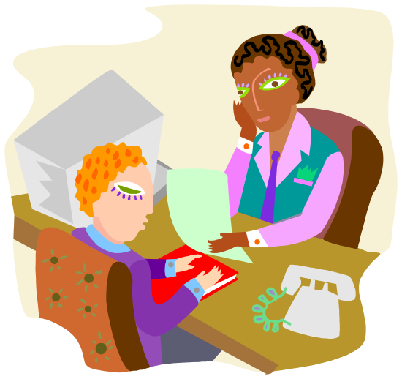
The Importance of Persuasion
Persuasion means making someone adopt a certain position, belief, or course of action.
Notes:
While discussing the importance of persuasion, state that business executives endorsing the profile of their company at a placement seminar should be persuasive so that they can attract good candidates.

Slide 3
The Skills to Persuasion
You need to use the following persuasive skills:
  Work your ideas in a plan.
  Introduce yourself.
  Speak with confidence and conviction.
  Be sensitive to the feeling and emotions of the people.
  Highlight the need of the product.
  Have thorough knowledge.
  Use adjectives and memorable phrases/slogans.
  Summarize the main ideas.

Slide 4

Activity: Understanding the Importance of Persuasion
In this activity, you will understand the importance of persuasion.

Slide 5

The Art of Negotiation
Negotiation is, undoubtedly, a part of everyday life.
The aim of negotiation is to explore a situation and find a solution that is acceptable to both parties.
One should be able to negotiate in many different situations to get the results that are wanted and needed every time.
Notes:
Tell the students that negotiation usually occurs between companies, groups, or individuals because both the parties involved are interested in something that the other party possesses and are willing to bargain for the same.

Slide 6
The Art of Negotiation (Contd.)
Clear communication is the key to effective negotiation.
The following communication skills are critical for negotiating effectively:
  Listening
  Understanding
  Speaking

Slide 7

Strategies to Negotiate
The basic strategies to negotiation are:
  The win-win strategy
  The win-lose strategy
  The lose-win strategy
  The lose-lose strategy
Notes:
Discuss the basic strategies to negotiation. Emphasize that in an integrated approach, the major concern is to maximize joint outcomes whereas in a distributive approach, the dominant concern is one’s own interests.

Slide 8
The Negotiating Process
The negotiating process encompasses the following six basic steps:
  Knowing each other
  Building a favorable atmosphere
  Initiating the process
  Expressing disagreement
  Knowing your BATNA (Best Alternative To a Negotiated Agreement)
  Recognizing compromise
Notes:
Mention the fact that once an agreement is reached, it is necessary to confirm it. This implies placing the agreed terms in writing.

Slide 9
Activity: Understanding the Negotiation Process
In this activity, you will learn the process of negotiation.

Slide 10
Guidelines for Successful Negotiation
Consider the following guidelines in order to make sound decision during negotiations:
  Identify negotiation goals and time
  Choose the right moment
  Be objective
  Visualize your opinions
  Use phrases
  Affirm and summarize
Notes:
Tell the students that while negotiating, use the question, “What would you suggest?” as often as possible. Highlight the fact that negotiation is constant game of give and take and they should not consider compromise as a defeat.

Slide 11
Activity: Negotiating Effectively
In this activity, you will learn to negotiate effectively.

Slide 12
Summary
In this session, you learned that:
  Persuasion means making someone to adopt a certain position, belief, or course of action.
  You need to use the following persuasive skills:
    Work your ideas in a plan.
    Introduce yourself.
    Speak with confidence and conviction.
    Be sensitive to the feeling and emotions of the people.
    Highlight the need of the product.
    Have thorough knowledge.
    Use adjectives and memorable phrases/slogans.
    Summarize the main ideas.
Notes:
Use this slide and the following slides to summarize the key concepts of the session to the students.

Slide 13
Summary (Contd.)
  The aim of negotiation is to explore a situation and find a solution that is acceptable to both parties.
  The following important skills of communication are critical for negotiating effectively:
    Listening
    Understanding
    Speaking
  The basic strategies to negotiation are:
    The win-win strategy
    The win-lose strategy
    The lose-win strategy
    The lose-lose strategy

Slide 14
Summary (Contd.)
  The negotiating process encompasses the following six basic steps:
    Knowing one another
    Building a favorable atmosphere
    Initiating the process
    Expressing disagreement
    Knowing your BATNA
    Recognizing compromise

Slide 15
Summary (Contd.)
  Consider the following guidelines in order to make sound decision during negotiations:
    Identify negotiation goals and time
    Choose the right moment
    Be objective
    Visualize your opinions
    Use phrases
    Affirm and summarize

